Slide 1
Lab 10 - UART

Slide 2
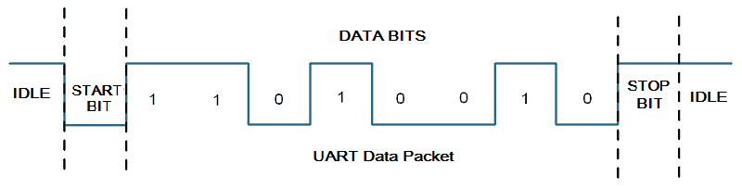
Introduction - UART
Universal Asynchronous Receiver Transmitter
Each character (data byte) is placed in between the start and stop bits. The start bit is always 0 (low) and the stop bit is always 1 (high).
3 important components:
Asynchronous transmitter
Asynchronous receiver
Baud rate generator

Slide 3
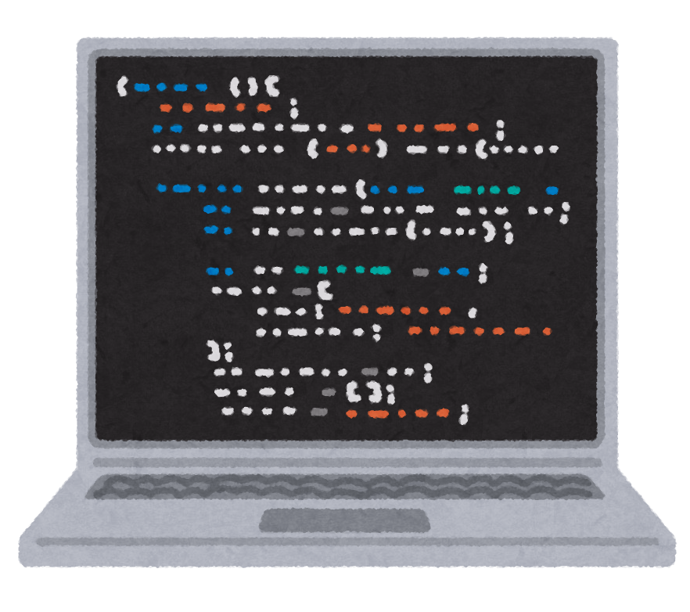
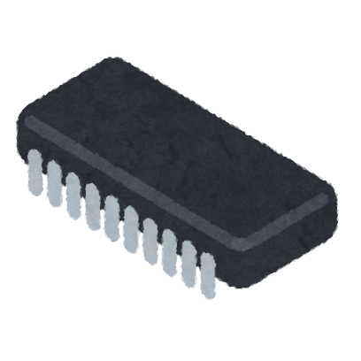
Experiment Setup
green wire of TTL
Asynchronous Receiver
RX pin
PIC18F4520
white wire of TTL
Asynchronous
Transmitter
TX pin

Slide 4
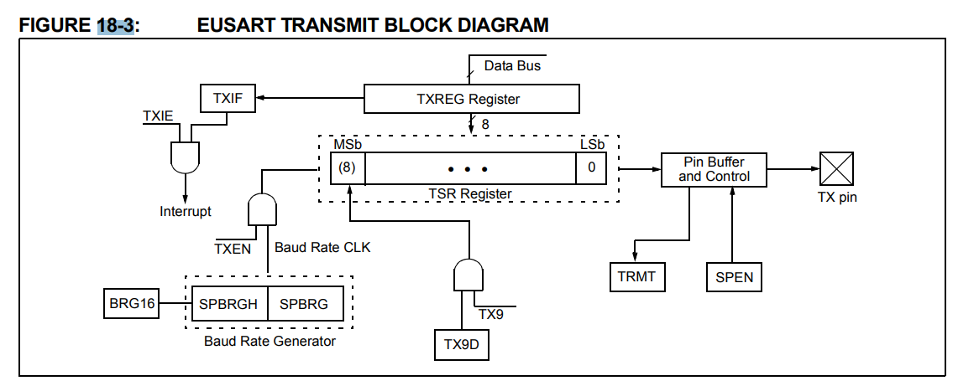
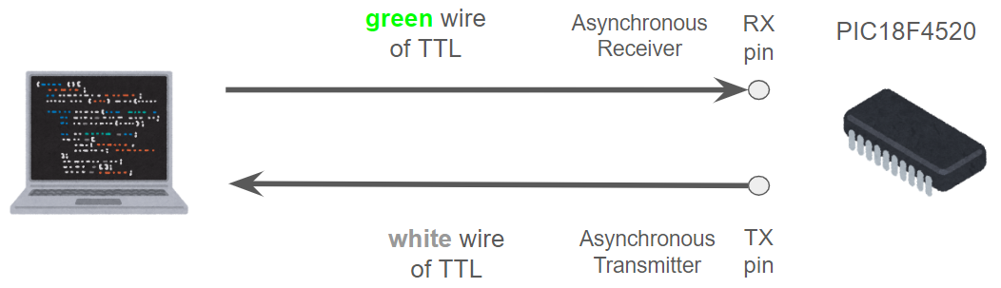
Asynchronous transmitter
Register bit needed to set:
TXEN (TXSTA<5>): Enable transmission.
SPEN (RCSTA<7>): Enable asynchronous serial port.
Register bit will set while transmit:
TRMT (TXSTA<7>): Read only, which is set when the TSR register is empty.
TXIF (PIR1<4>): Set when TXREG is empty
Reference: Datasheet p.211 FIGURE 18-3

Slide 5
Asynchronous transmitter
Set up asynchronous transmission:
Set the baud rate correctly
Enable the asynchronous serial port by clearing SYNC (TXSTA<4>), and setting SPEN (RCSTA<7>)
If interrupt is desired, set TXIE (PIE<4>)
Enable the transmission by setting TXEN (TXSTA<5>), which will also set TXIF bit.
Load data to TXREG register to start transmission.
Reference: Datasheet p.214

Slide 6
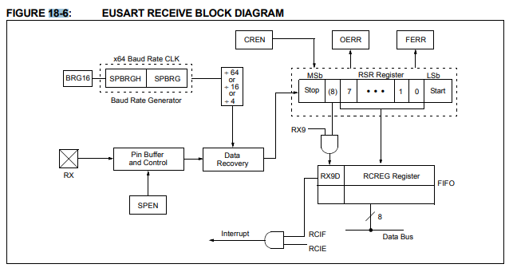
Asynchronous receiver
RCIF (RIR1<5>): will set when reception is complete
SPEN (RCSTA<7>): enable asynchronous serial port
OERR, FERR: error detect
CREN: continuous receive enable bit, will be cleared when error occurred
Reference: Datasheet p.213 FIGURE 18-6

Slide 7
Asynchronous receiver
Set up asynchronous reception:
Set the baud rate correctly
Enable the asynchronous serial port by clearing SYNC (TXSTA<4>), and setting SPEN (RCSTA<7>)
If interrupt is desired, set RCIE (PIE<4>)
Enable the reception by setting bit, CREN (RCSTA<4>)
Read the 8-bit received data by reading the RCREG register
Reference: Datasheet p.216

Slide 8
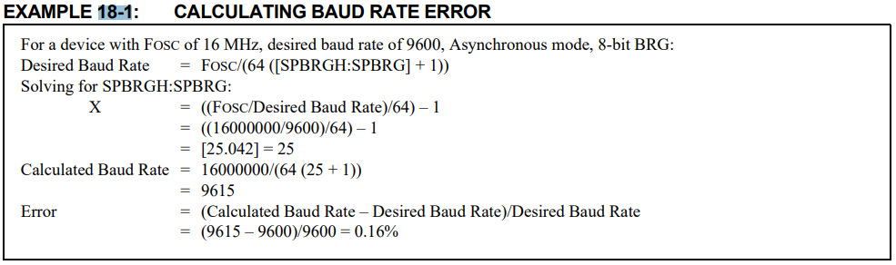
Baud Rate
BRG16 (BAUDCON<3>): choose 16-bit or 8-bit baud rate generator
16-bit: SPBRGH and SPBRG
8-bit: SPBRG only
SYNC (TXSTA<4>): EUSART Mode Select bit, we use async mode
BRGH (TXSTA<2>): High Baud Rate Select bit
SPBRGH : SPBRG: controls the period of a free-running timer
Reference: Datasheet p.206 EXAMPLE 18-1

Slide 9
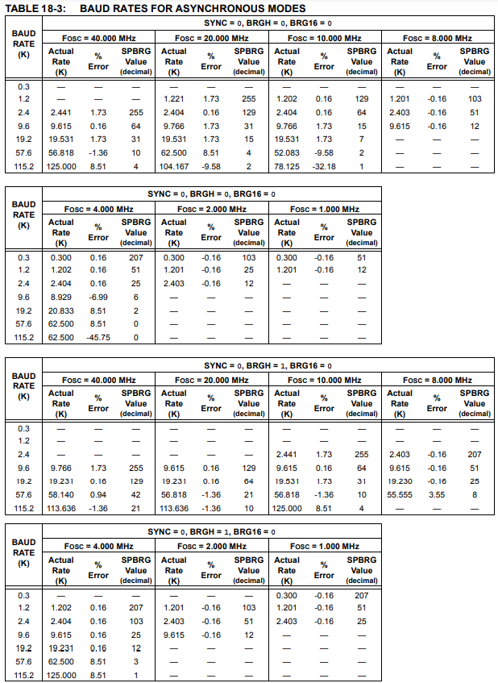
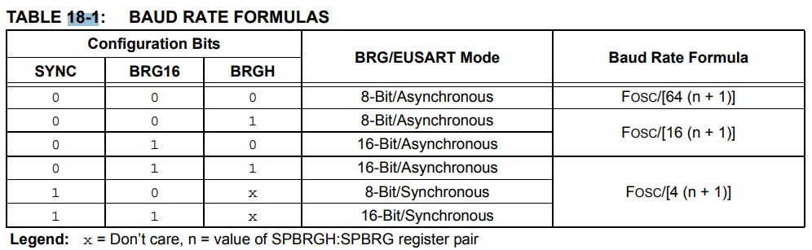
Baud Rate (Cont’)
Reference: Datasheet p.206 - 208

Slide 10
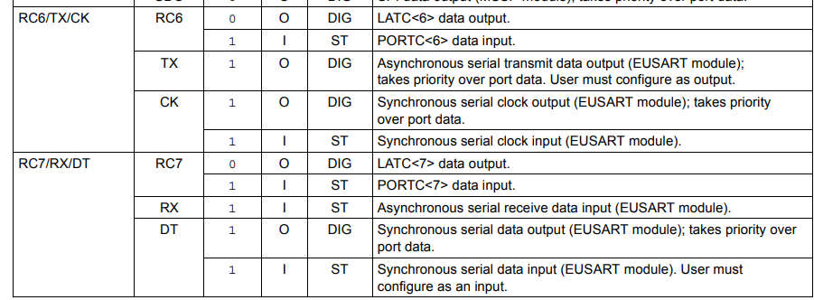
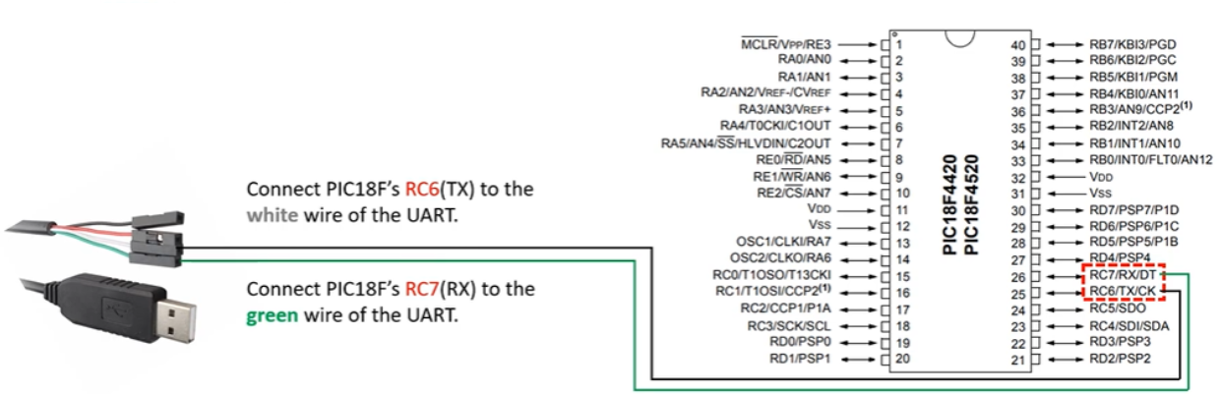
Setting UART pin
Reference: Datasheet p.112 TABLE10-5
The pins of the Enhanced UART are multiplexed with PORTC.
In order to configure RC6/TX/CK and RC7/TX/DT as a UART:
Bit SPEN (RCSTA<7>) must be set to 1
Bit TRISC <7> must be set to 1
Bit TRISC <6> must be set to 1.

Slide 11
Reference
PIC18F4520 Datasheet: https://ww1.microchip.com/downloads/en/DeviceDoc/39631E.pdf

